Slide 1
City of Chehalis Proposed Amendment to the 2020 Budget 3/9/2019 Presenter: Chun Saul

Slide 2
Discussion
Amendment to the 2020 Budget includes:
Update 2020 beginning fund balances
Carry over 2019 capital budget balance
Requests for new appropriation
What’s not included:
Additional wages/benefits due to labor union negotiations (2020 Adopted Budget includes 2% COLA)
Fire station property acquisition
A&E cost for new fire station

Slide 3
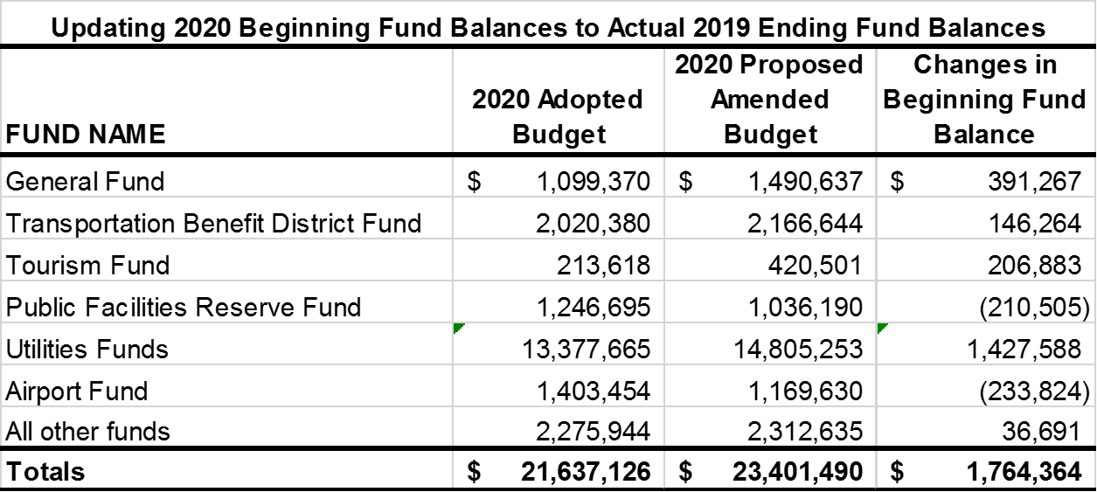
2020 Beginning Fund Balance Update City-wide
From Estimates to Actual at Year End 2019
Total increase by $1.76 million

Slide 4
General Fund – 2020 Proposed Budget Amendment Summary
What’s Includes:
Updating beginning fund balance
Flood Storage Master Plan Ph2 $316,676 (100% grant funded)
Fire SCBA equipment city match & purchase of spare units $37,440
Police SWAT budget increase $540
What’s Not Included:
Potential payroll budget increase due to labor union negotiations. (2020 Adopted Budget includes 2% COLA)
Police request for a garage construction ($45K-70K)
Appx. $42.5K for A&E service for new fire station ($161K less $30K proposed budget amendment, less $88.5K available in Fund 301)

Slide 5
Proposed 2020 Budget Amendment City-wide Summary

Slide 6
Carry Over 2019 Capital Budget Balance City-wide
Projects expected to be completed in 2020 and require 2019 budget carry-over.

Slide 7
Additional Budget Requests – City-wide

Slide 8
Closing
Questions?
Recommendations:
It is recommended that the City Council approve the proposed budget amendment and Pass Ordinance No. 1006-B on first reading

