Slide 1
2019 Second Quarter Financial Report Period Ending June 30, 2019
Presenter: Chun Saul
7/22/2019

Slide 2
Discussion
2019 Second Quarter (January through June) Operating Results
Budget to Actual Comparison – Target 50% (6/12 months)
City-wide Total for All Funds Combined Overview
General Fund Overview
Revenues, Expenditures & Fund Balance Summary
Revenues by Source – Budget to Actual and Trend
Expenditures by Department – Budget to Actual
Enterprise Funds Overview
Combined Utilities Funds (Wastewater, Water, Storm Water)
Airport Fund
Treasurer’s Report
Cash, Deposits & Investments as of 6/30/2019

Slide 3
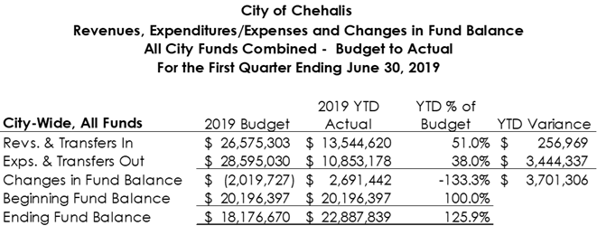
Overview – All City Funds Combined
YTD revenue variance:
General fund property tax and TBD sales tax ahead of YTD target
Transfers between funds 83% complete
YTD expenditures and transfers-out is 38.0% of the 2019 budget.
Operating expenditures is $8,604,003 or 47.4% of the 2019 budget
Capital outlays spent $293,440 or 4.3% of the 2019 budget
Projects expect to take off after 2nd quarter
Bottom Line: Overall, YTD revenues and expenditures are as projected and within budget parameters for the 2nd quarter.

Slide 4
General Fund Overview
Bottom line: For the most part, the General Fund operated within the budget parameters.

Slide 5
General Fund Revenues -Budget to Actual
Property Tax: Ahead of the YTD target. This is due to the timing of processing rather than an increase in revenues and is expected to even out over the next payment period. (2019 GF property tax budget $122,403 increase from 2018 from use of banked capacity and 1% increase)
Sales and Use Tax includes: Local regular sales and use tax, Brokered Natural Gas, and Criminal Justice sales tax. Local regular sales and use tax YTD is $77,605 below the YTD target amount while other sales taxes received is $57,234 ahead of the YTD target amount.
Utility tax includes: electric, gas, telephone, cable, solid waste, water and sewer business.
Charges for Goods & Services: includes plan check review fees, police & fire services, and recreation program fees. Recreation program fee makes up 51% of this category. Most revenues received during summer months.

Slide 6
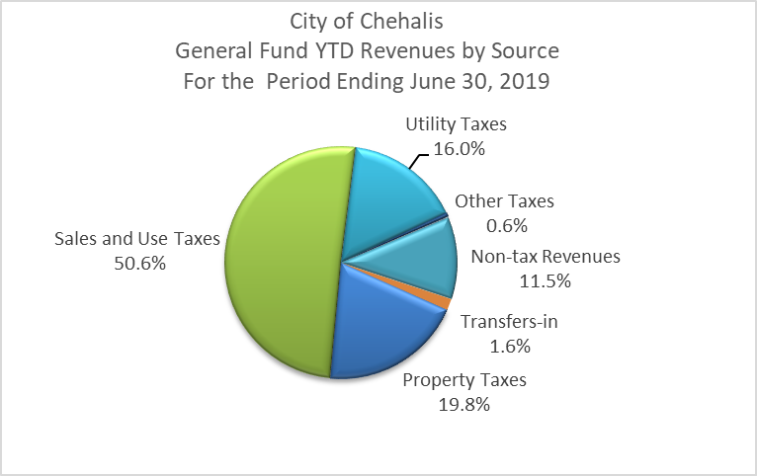
General Fund Revenues by Source
Total tax revenues make up 87.0% of total general fund revenues received.
Sales tax is the largest revenue source and makes up 50.6% of total revenues received.
Local regular sales & use tax
Brokered Natural Gas sales tax
Criminal Justice sales tax
Utility taxes make up 16.0% of total received and includes: electric, gas, telephone, cable, solid waste, water & sewer business.
YTD Telephone utility tax is 39.0% of the 2019 budget ($27K below target)
YTD electric utility tax is 56.4% of the 2019 budget ($35K above the target)
Non-tax revenues include: charges for goods & services, intergovernmental revenues (state shared and grants), fines, and other misc.

Slide 7
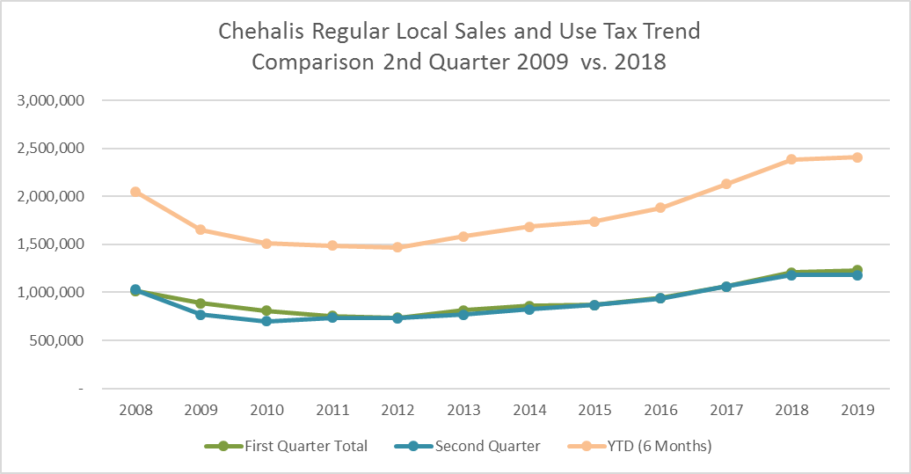
General Fund Revenues – Regular Local Sales Tax Trend
Regular local sales tax rate = 1% (total tax rate 8.2%)
2- month lag time between month of sales and revenue distribution.
2019 YTD is $2,409,186 or 48.47% of the 2019 budget:
$171,469 (7.1%) from construction
$75,904 below YTD target.
2Q 2019 Comparison to 2Q 2018:
Overall increase $23,017 (or 1%)
Increase during 1st Quarter $23,229K
Decreased during 2nd Quarter -$212
Sales tax from non-construction sources increased 4.7% or $100,600
Sales tax from construction activities decreased by $77,605 (31.2%)

Slide 8
General Fund Expenditures by Department and Activity – Budget to Actual
Overall, for the most departments operated within normal budget parameters. Exceptions:
HR: Professional services related to collective bargaining union negotiations
Fire: Space rent for temporary fire station; 2019 H.S.A contributions for firefighters paid in first half; annual WCIA insurance paid in first half
Planning & Building: Consultant service $85K for flood storage master plan phase 2. Approved by the Council in Nov. 2018 but not included in the 2019 adopted budget.

Slide 9
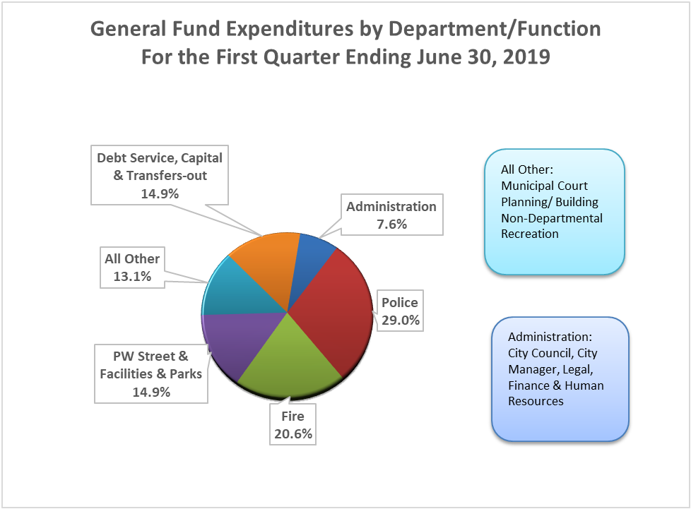
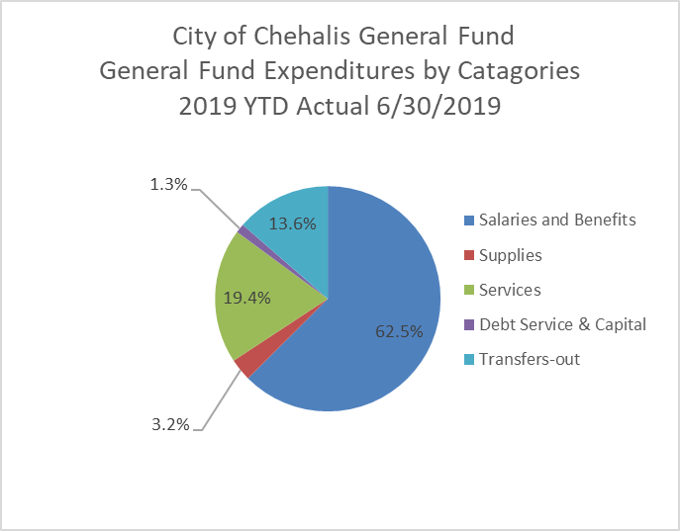
General Fund Expenditures Proportion – By Department & By Category
Police and Fire make up 49.6% of the General Fund YTD total expenditures & transfers-out.
It is 58.6% of the Genera Fund’s operating expenditures (excluding capital, debt service & transfers).
YTD Salaries and Benefits $3,436,997 (48.1% of the 2019 budget). It is 62.5% of the General Fund YTD expenditures and transfers-out, or 73.5% of the total operating expenditures (excluding capital, debt service, and transfers)

Slide 10
Enterprise Funds Summary
Combined Utilities Funds (Wastewater, Water & Stormwater)
Operating revenues received YTD is 56.6% of the 2019 annual Budget
Charges for fixed and volume: 50.4% of the annual budget
Other operating revenues (i.e. late fees & interest): 96.1% of the annual budget
Operating expenditures YTD is 48.1% of the 2019 Budget
Capital expenditures YTD is 5.3% of the 2019 budget
Debt service YTD is 43.3% of the 2019 budget
Overall, total revenues exceeded total expenditures by $715,316
Airport Fund
Operating revenues received YTD is 53.8% of the 2019 budget
Fuel sales 60.5% ; Rents & Leases 49.8%
Operating expenditures YTD is 48.8% of the 2019 budget
Capital expenditures YTD is 1.8% of the 2019 budget
Taxiway Realignment project ($2.8Mil)expected to start in July
Overall, YTD total revenues exceeded total expenditures by $332,905

Slide 11
Treasure's Report
The City’s total cash, deposits & Investments as of June 30, 2019 is $22,887,839,
Other than the General Fund, all other funds are restricted funds which accounts for specific revenues or resources that are legally restricted or designated to finance particular activities the city (i.e., utilities, airport, TBD, etc.)
Summary totals by funds:
About 82.7% or $18,922,462 of the total was invested and earned interests. ($16.4 Mil in LGIP, $2.4Mil in US Govt Agency Bonds)
YTD Investment interest earned through June 2019 is $211,050.
The average annual net earnings rate for Local Government Investment Pool (LGIP)for the 1st quarter was 2.5192%.

Slide 12
Closing
Questions?
Thank you!

