Slide 1
City of Chehalis Proposed Second Amendment to the 2019 Budget Ordinance No. 1000-B 07/22/2019 Presenter: Chun Saul

Slide 2
Discussion
Proposed Amendment to the 2019 Budget
Second amendment to the 2019 Budget
Total All City Funds Combined (City-Wide) Overview
General Fund Overview
Public Facilities Reserve Fund Overview
Other Funds Overview
Recommendation to Pass Ordinance No. 1000-B on first reading.

Slide 3
Overview of 2019 Budget Amendment– All Funds (City-Wide)
Proposed Budget Amendment Includes:
Net City-wide Decrease in Fund Balance $704,757:
Fund Balance - Other than the General Fund, all other funds are restricted funds
Restricted funds account for specific revenues or resources that are legally restricted or designated to finance particular activities of the city, such as utilities funds.

Slide 4
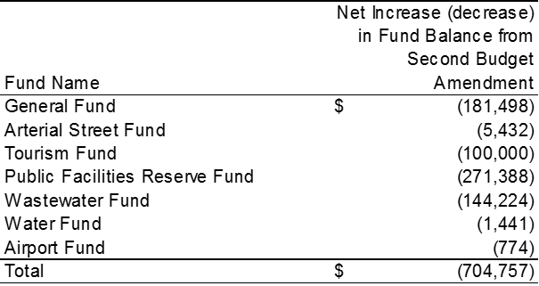
Overview of 2019 Budget Amendment– All Funds (City-Wide)-continued
Summary of Net Changes in Fund Balance by Fund:

Slide 5
Overview of 2019 Budget Amendment– General Fund
Net Decrease in General Fund Balance $181,498
Summary by Department

Slide 6
General Fund - Ending Fund Balance
Estimated ending fund balance of the General Fund is $790,431
This is 7.9% of the General Fund’s Operating Revenue
City Council policy is to maintain 10% operating reserves in the General Fund.

Slide 7
Overview of 2019 Budget Amendment– Public Facilities Reserve Fund
Amendment Summary
Recreation Park Renovation Project Budget $4,165,669
Funding Sources:
Transfer from Arterial Street Fund $5,432; Grants $1,600,000; Donations $1,473,064; beginning reserved cash $187,173 (donations received in prior year)
Bond Issue Appx. $900,000 Par, less issuance cost $19,000, Net proceed $881,000
Expenditures: Ballfield complex, Penny Playground, Other Improvement
The proposed budget amendment is for the full amount of estimated project budget. Ballfield complex portion of the project is expected to be substantially completed by the end of 2019; however Penny Playground and other improvement projects are most likely started in 2019 and completed in 2020. Any unspent 2019 budget appropriations will be carried forward to 2020 budget through a budget amendment in 2020.
Pool Liner Replacement Project Budget $287,430
Funding Sources: Transfers from General Fund $19K and from Tourism fund $100K and $82K transfer-in from Tourism fund approved in the 2019 adopted budget, and use of beginning cash $84K

Slide 8
Other Funds
Arterial Street Fund:
$5,432 transfer to Public Facilities Reserve Fund for Recreation Park Renovation Project
Tourism Fund:
$100K transfer to Public Facilities Reserve Fund for Pool Liner project (Carry forward 2018 appropriation not used)
Wastewater Fund
$144,244 increase in appropriations for consultants on SWCAA permit issue and change orders for certain capital projects
Water Fund
Revenue budget increase $744 for adjustment of interest on the interfund loan to the Airport Fund (to adjust to LGIP interest rate)
$2,215 increase in appropriations for retirees’ accrual cash outs.
Airport Fund
$744 increase in appropriation for adjustment of interest on the interfund loan from Water Fund.

Slide 9
Recommendation
It is recommended that the City Council approve the proposed budget amendment and
Pass Ordinance No. 1000-B on first reading

Slide 10
Closing
Questions or Comments?
Recommendation
It is recommended that the City Council approve the proposed budget amendment and Pass Ordinance No. 1000-B on first reading
Thank you!

