Slide 1
2020 Parks and Facilities Projects
10/12/2020

Slide 2
Completed 2020 Facilities Projects
Renovation of Recreation Park concession bathroom facility
Renovation of center area bathroom at Stan Hedwall Park
New concrete at Lintott Alexander Park
New playground chips at Lintott Alexander Park
Assisted in the completion of the Sports Complex and Penny Playground
Managed and completed the pool resurfacing project
New landscape installed at National Avenue

Slide 3
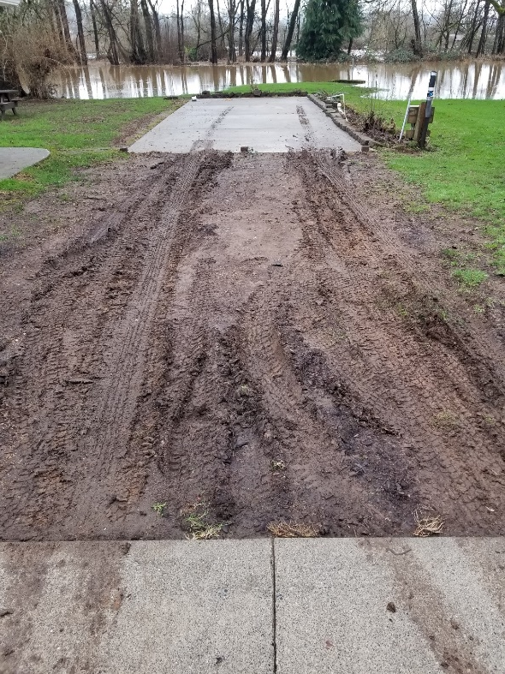
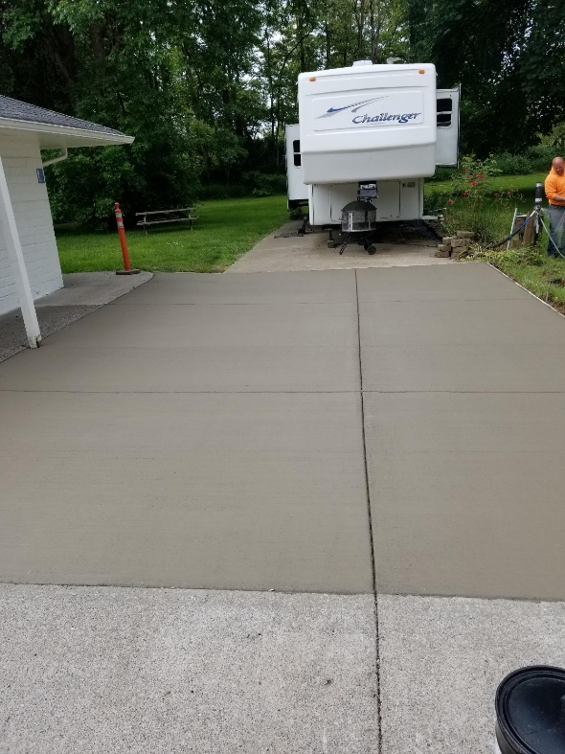
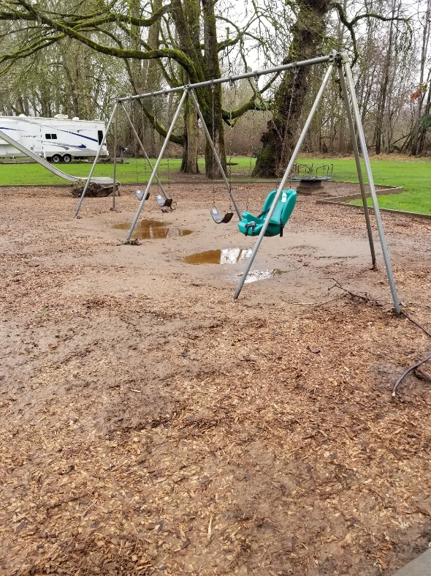
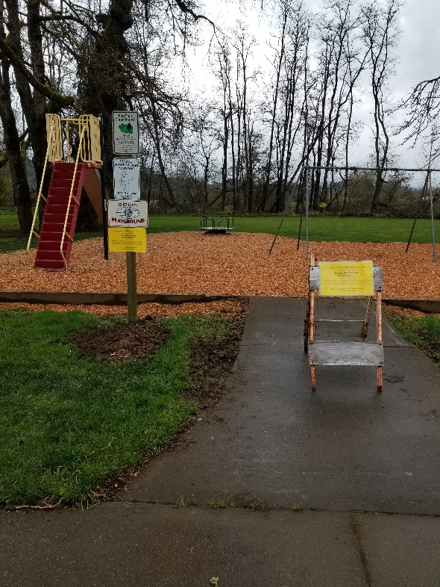
Lintott Alexander Park Concrete pad and playground chips installed
Before After Before After

Slide 4
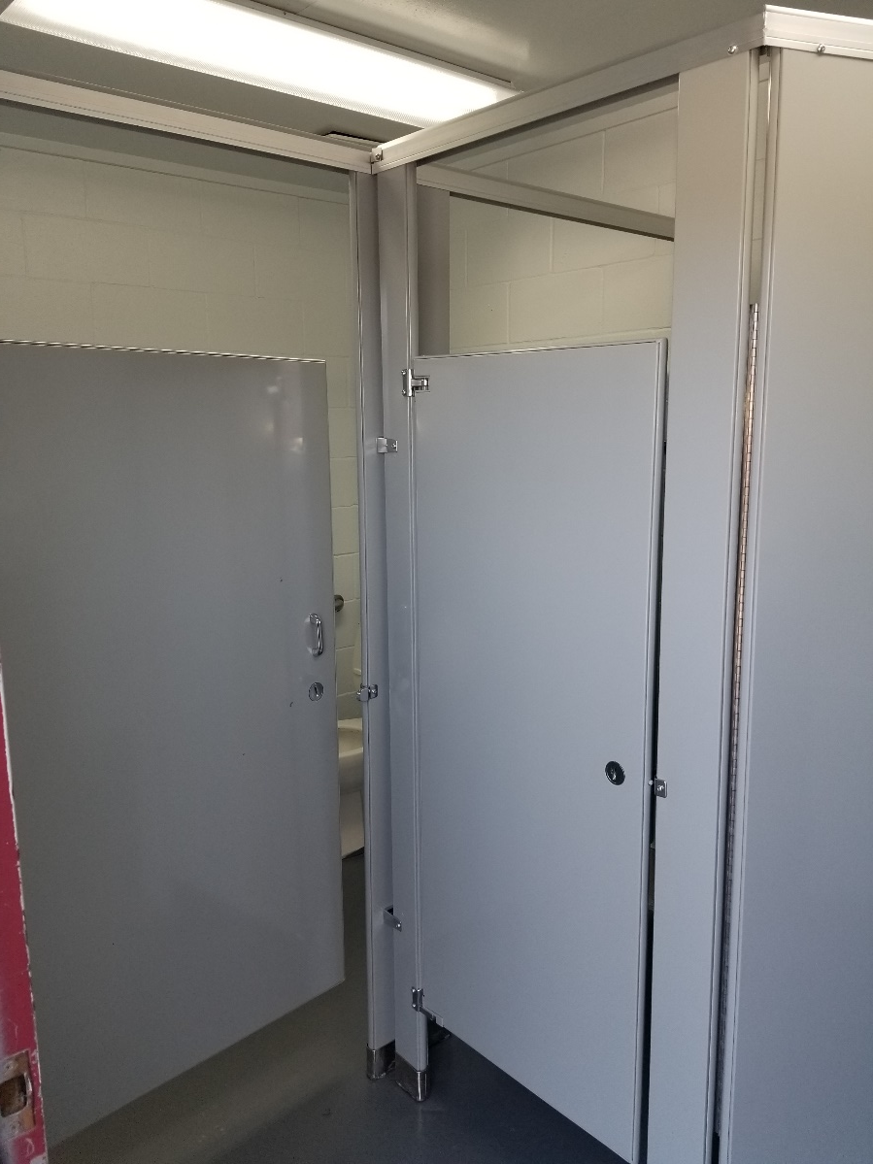
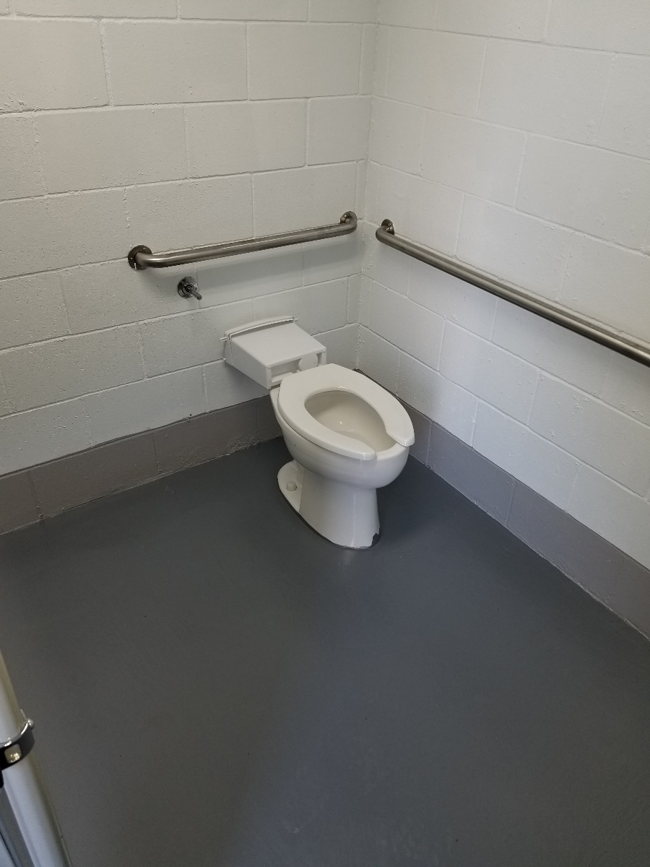
Recreation Park Concession Building Restroom remodel

Slide 5
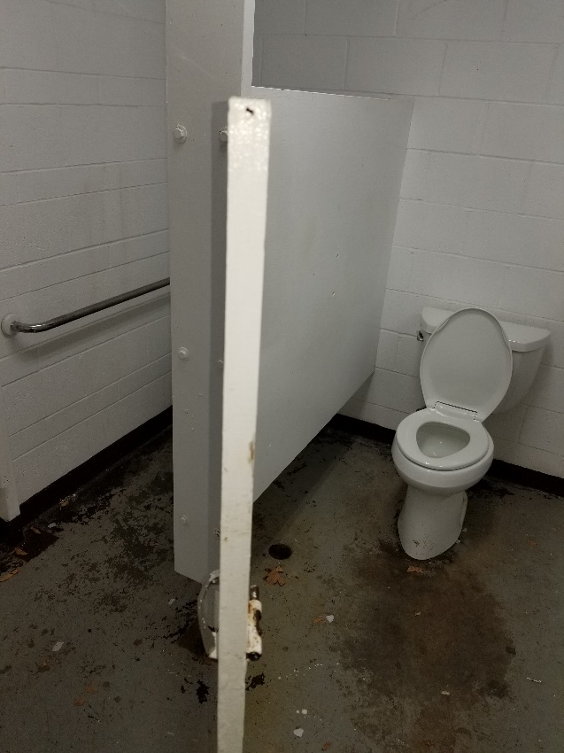
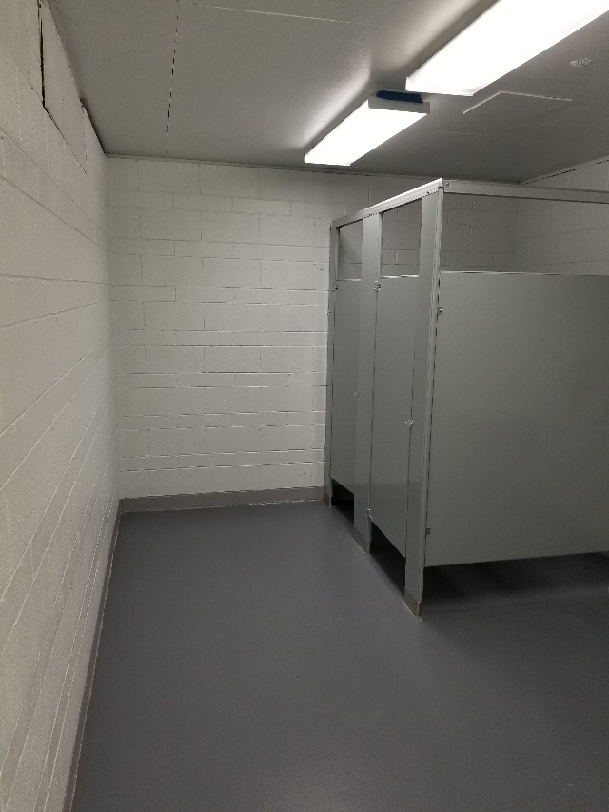
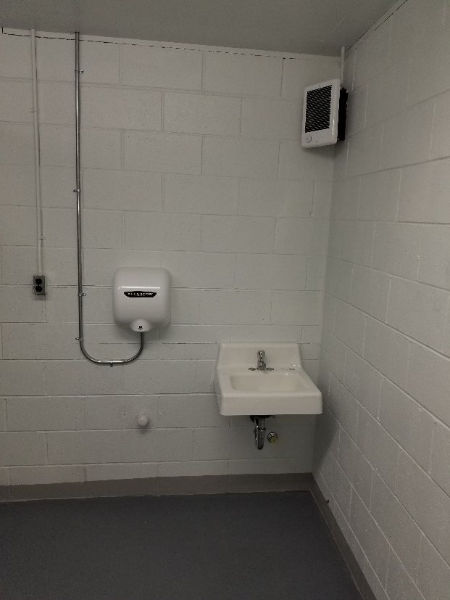
Stan Hedwall Park Center area restroom remodel
Before After

Slide 6
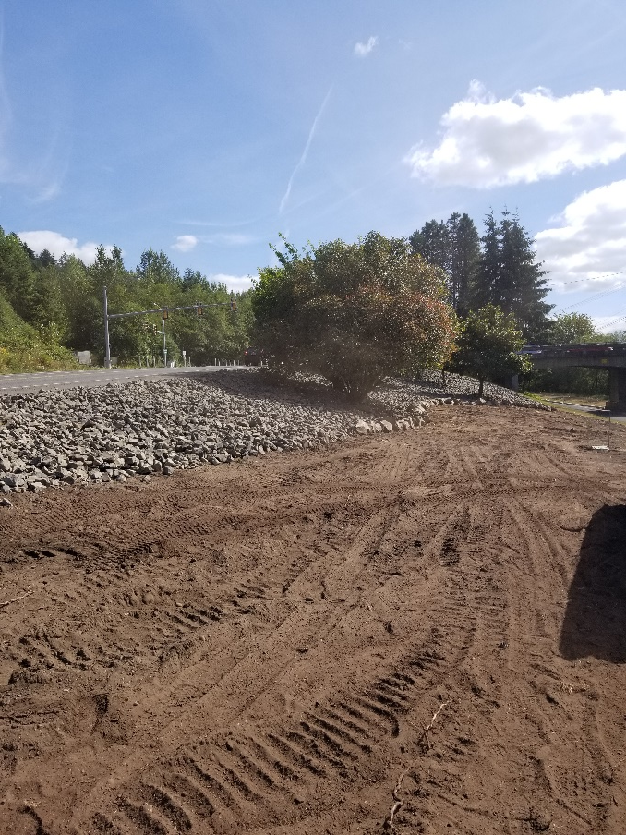
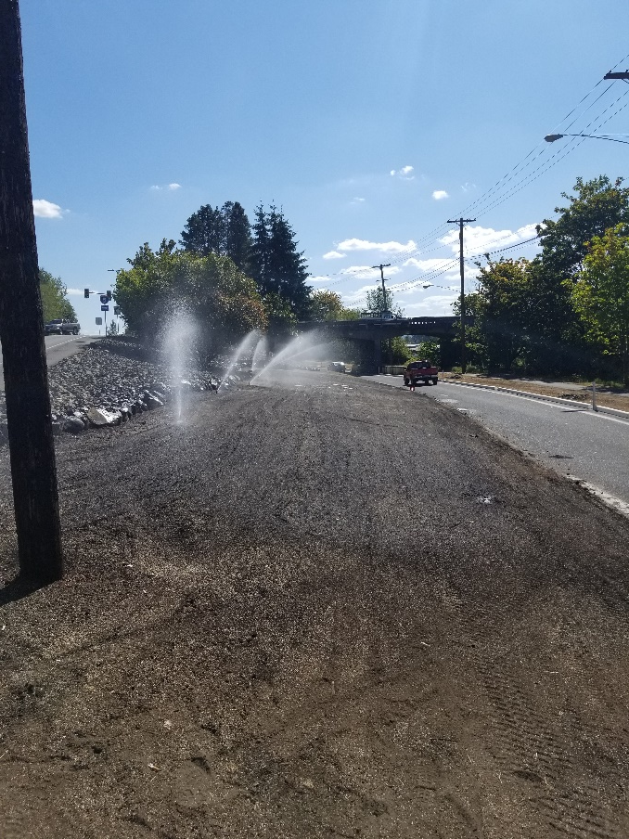
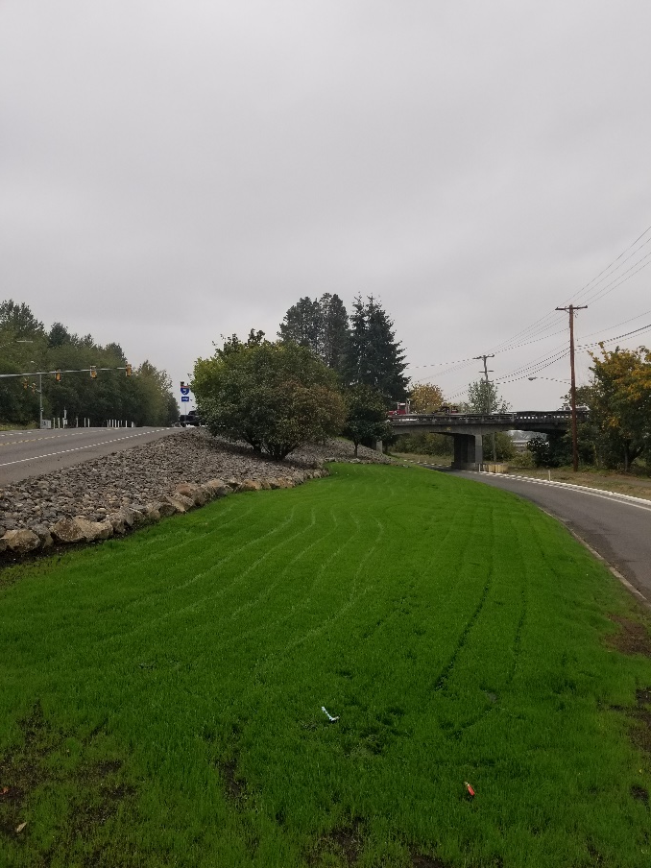
National Avenue Landscape Project
Rock Added Irrigation Installed Seed Planted

Slide 7
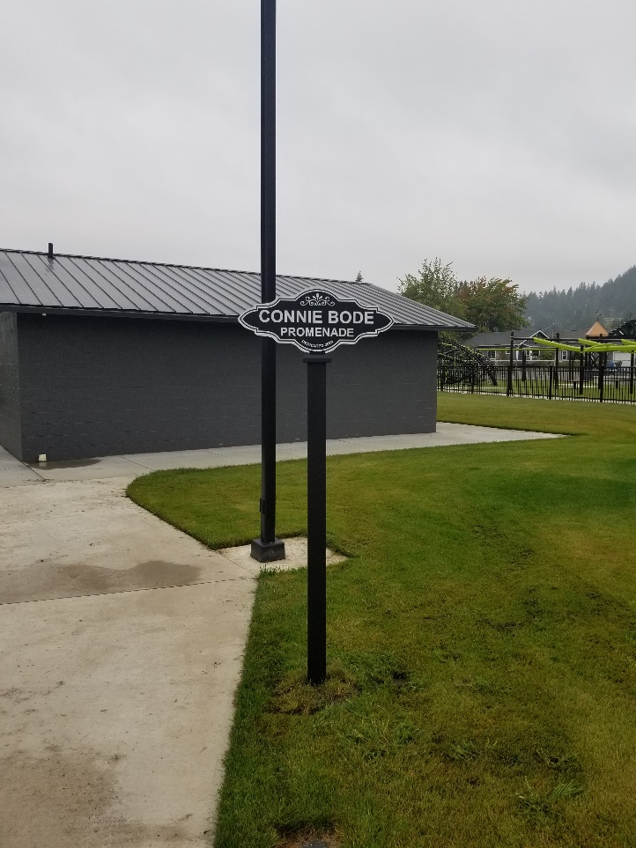
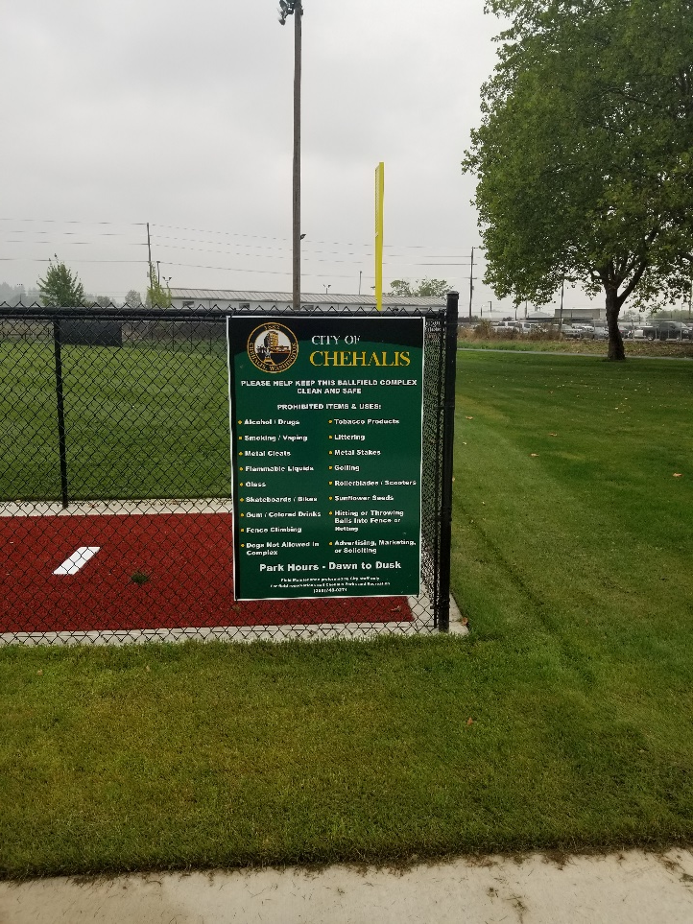
Sports Complex and Penny Playground Property crew installed: Signage, water station, benches, garbage receptacles, and lending library

Slide 8
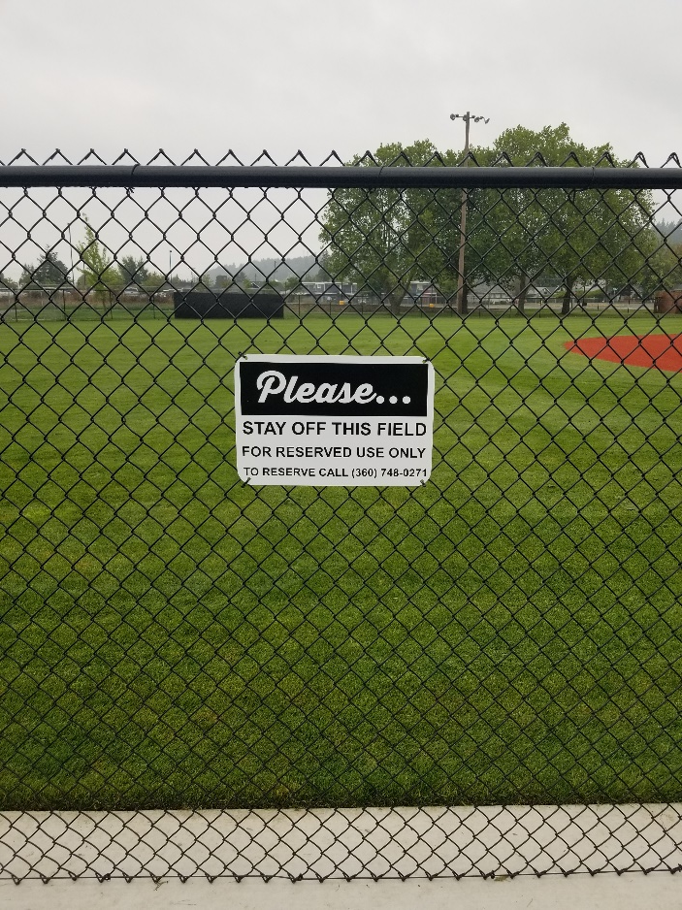
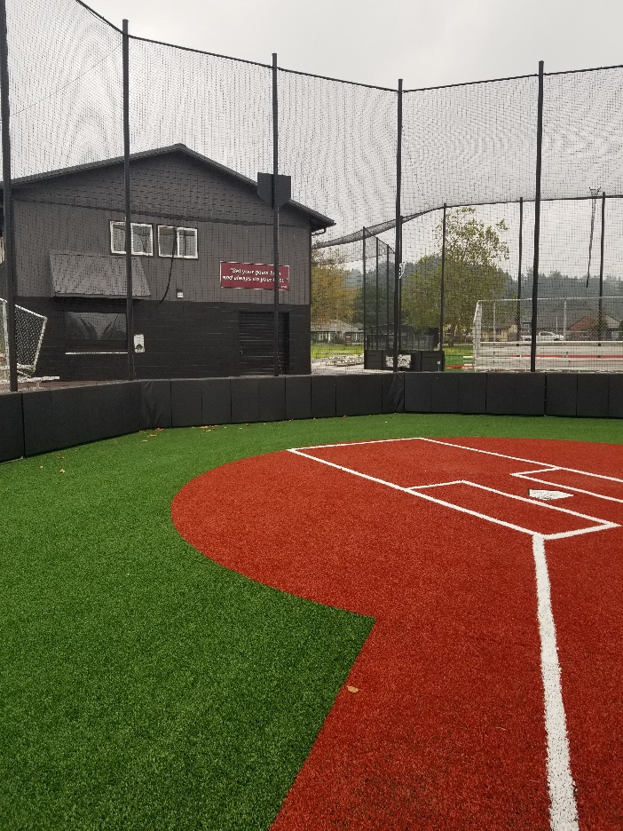
Sports Complex and Penny Playground (continued)

Slide 9
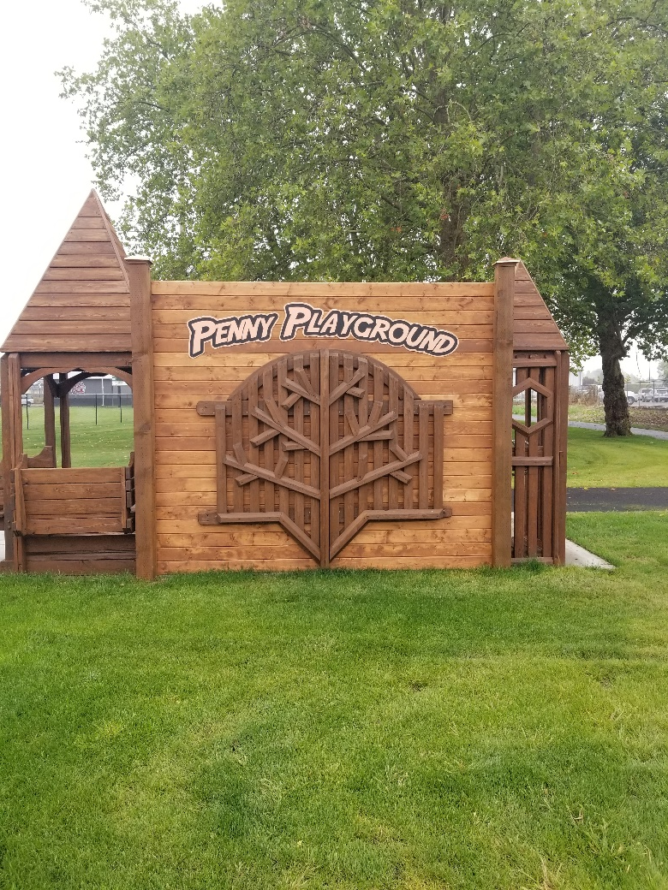
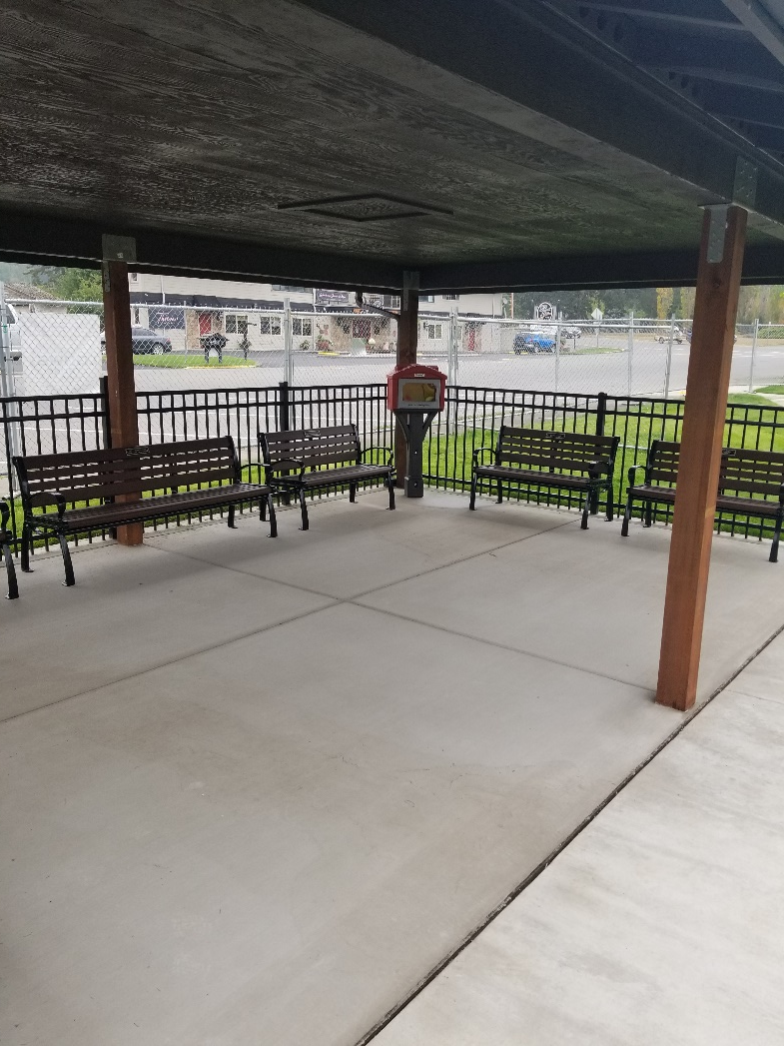
Sports Complex and Penny Playground (continued)

Slide 10
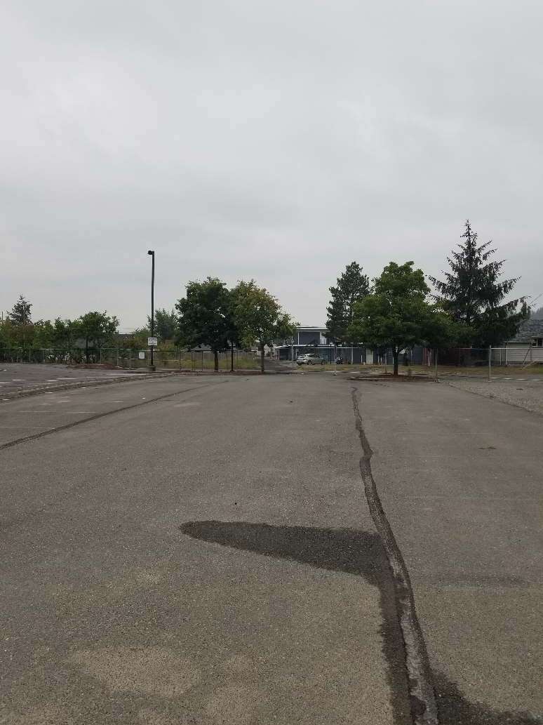
Recreation Park: Parking Lot Upgrade Property staff with help from the Street Department: Cleaned up landscape beds, swept lots with street sweeper, crack sealed, and painted parking stalls

Slide 11
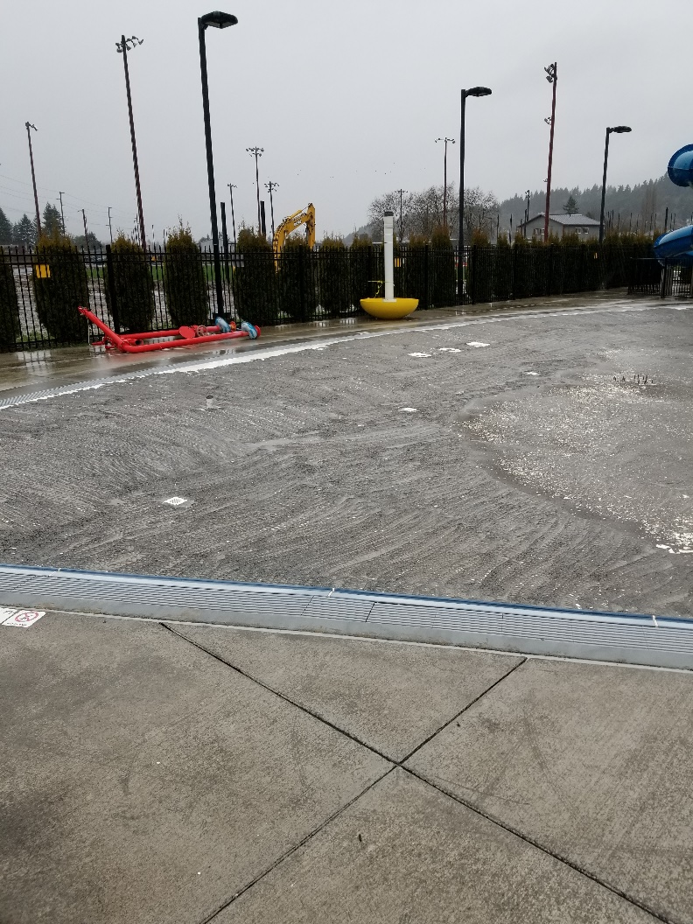
Shaw Aquatics Center Pool resurfacing project: demo

Slide 12
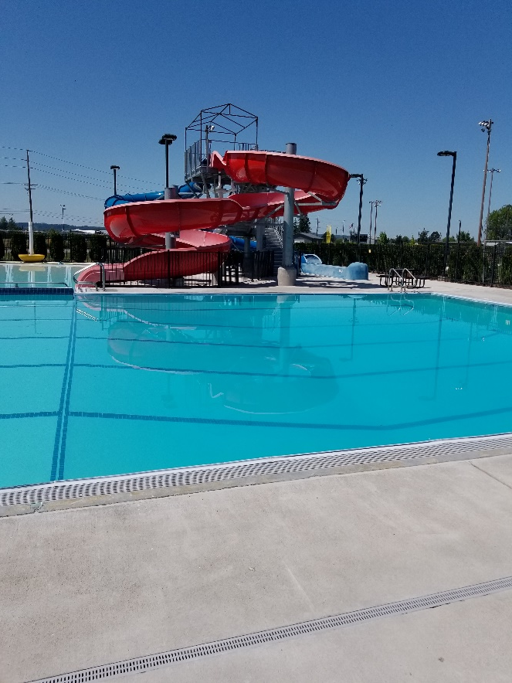
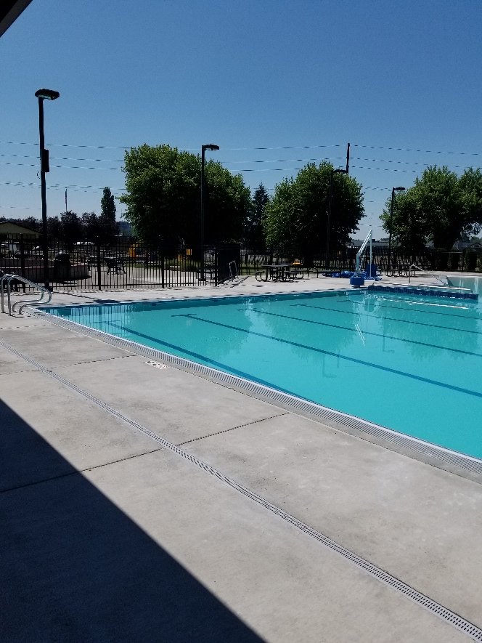
Shaw Aquatic Center Pool resurfacing project: complete

Slide 13
2020 Parks and Facilities Projects

